Slide 1
Molecular Dynamics sim.
The 2nd Innovation Camp for Computational Materials Science
“Cooperation between applied mathematics and computational materials science by utilizing numerical libraries”
2018/10/04
@Yonago city, Tottori pref.
molecular dynamics group

Slide 2

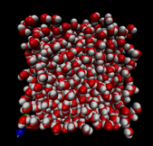
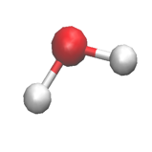
3-1. Computational details
1. intro. : Molecular Dynamics
Simulation in different scales
macro
Continuum system
Fluid mechanics
FEM method
Molecule assembly system
Classical mechanics,
Statistical mechanism
MD method
MC method
Many electron-nucleus system
Quantum mechanics
MO method
DFT method
QMC method
micro

Slide 3

1. intro. : Molecular Dynamics
Molecular dynamics (MD) simulation package
AMBER
CHARMM
LAMMPS
MODYLAS …
http://www.gromacs.org/
designed for studying biological macromolecules based on the MD simulation
FAST! FREXIBLE! FREE SOFTWARE !!!

Slide 4
2. How to install GROMACS
- Make a directory to install the GROMACS.
mkdir practice
- Next, you need to download the tar file of Gromacs using wget.
cd practice
wget ftp://ftp.gromacs.org/pub/gromacs/gromacs-5.1.5.tar.gz
- Use cmake to install GROMACS linked with fftw3 from the internet directly.
mkdir build
cd build
cmake .. \
-DGMXBUILD_OWN_FFTW=ON \
-DCMAKE_INSTALL_PREFIX=install_dir \
-DGMX_SIMD=SSE2 \
-DGMX_DOUBLE=ON \
-DGMX_MPI=ON
make
make check
make -j 4 install
- The binary files should be found in install_dir/bin/.

Slide 5
3. How to use GROMACS
NPT calculation for ethanol molecule in water
- Let’s run a test calculation which uses the sample files in “./app/sample/from_file”.
- Make a new directory
make test
- We need to prepare four input files:
1. solution_run.mdp All the input parameters for MD simulation.
2. solution.gro Information of the studied structure.
3. etohsolution.top Information of the applied force field.
4. run.sh Script for the queuing system.
(All the input files can be found in gauss. Please take a look at the files.)
- Submit the job
make test
cd test
qsub run.sh
- Output files
md.edr The physical properties (e.g. energy) are stored.
md.xtc A portable format for the trajectories.
mdout.mdp Containing parameters performed by MD.
- The output file, md.xtc, can be read by VMD (the input file, solution.gro, is also needed).

Slide 6
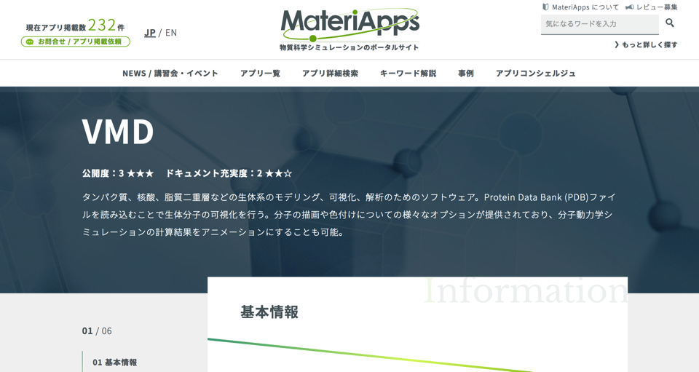
VMD is also available in MateriApps!

Slide 7
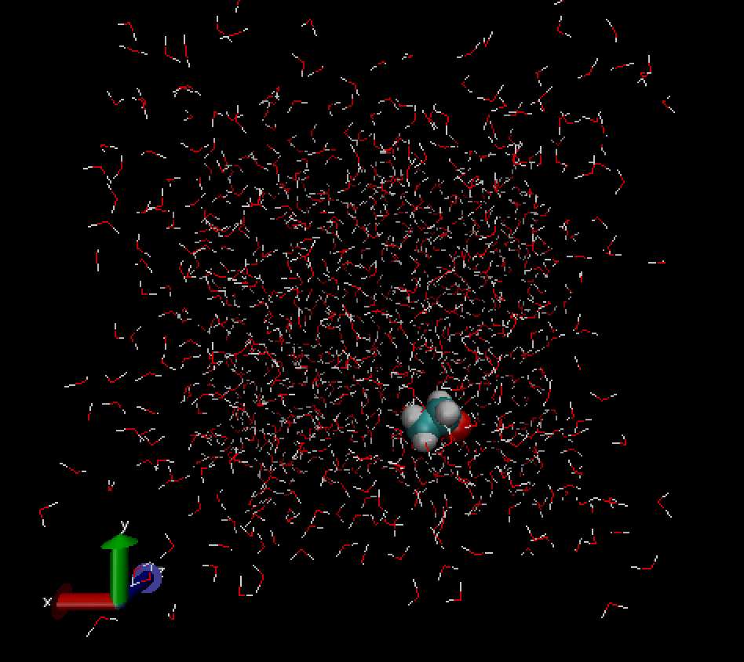
4. demo. : NPT calc. for ethanol in water

Slide 8
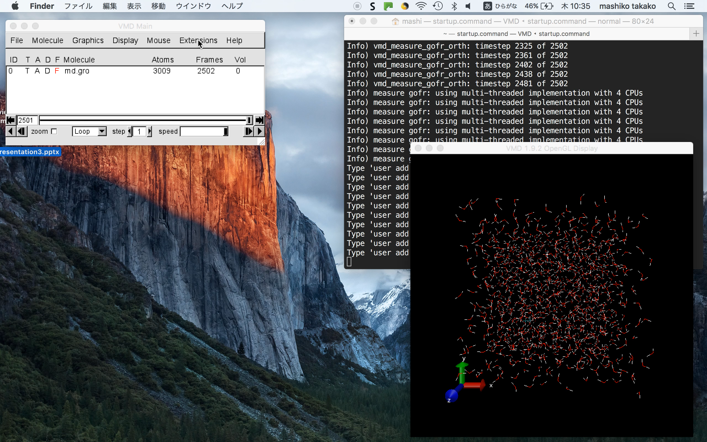
Let’s make RDF using VMD !

